Slide 1
Categorize affected business according to FEMA’s seven lifelines, before and during a disaster, using Yelp data.
DSI Project 5 for New Light Technologies
Briefly, this tool will utilize Yelp to estimate the effects of the event on each of the seven lifelines.
Samay Shah
Ali Habibi

Slide 2
Topics For this presentation,
High Density
Data Collection
Understanding how and from where to collect data. Types of API’s available and how they function.
Exploratory Data Analysis
Understanding the available data and using different API’s to plot and categorize FEMA’s 7 lifelines.
High Density
Summary and Conclusions
Cluster each lifeline individually and understand the changes between the years 2019 and 2021.
Notes:
Houston is made up of 9 counties: HarrisFort, Bend, Montgomery, Brazoria, Galveston, Liberty, Waller Chambers, Austin

Slide 3
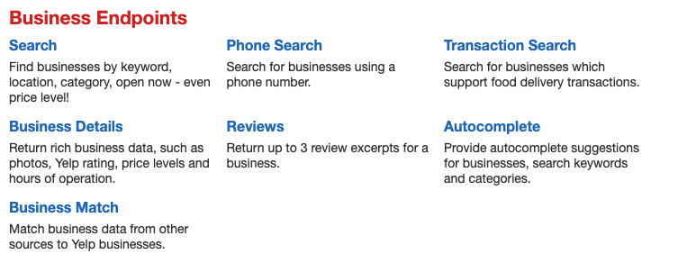
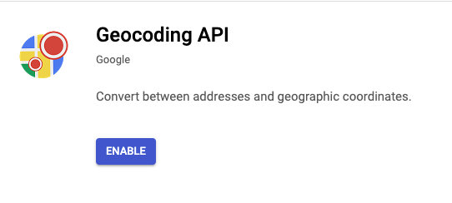
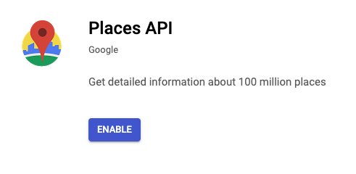
Data Collection (Libraries & API)
Yelp Fusion API
Robust search results, main benefit being able to search using venue id’s. Focuses more on business information rather than overall search results.
Google Places API
Part of Google Cloud Platform. Used Places API and Geocoding API for this project. Allows to search using keywords.
Allows to send HTTP requests using Python. HTTP returns the response object ex. JSON file in our case comprising of related data like content, status, encoding etc.
Requests Library

Slide 4
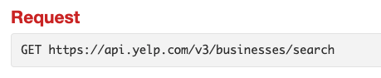
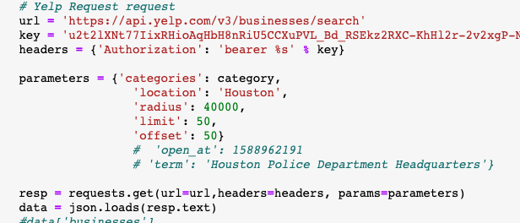
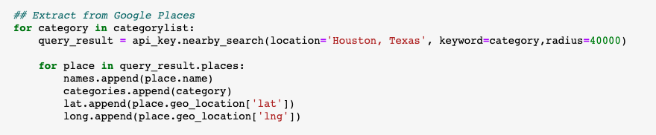
Sample Request call using yelp API
Search business based on following parameters,
location
latitude & longitude
radius
categories
limit
offset
open_now
open_at
The GET method indicates that you’re trying to get or retrieve data from a specified resource
We obtain the response as a JSON file, and all content is stored under ‘businesses’ key.

Slide 5
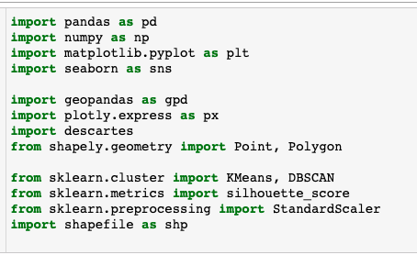
Exploratory Data Analysis (Additional Libraries)
Geopandas Library
Other Libraries
An open source library to work with geospatial data in python. Extends the datatypes used by Pandas to allow spatial operations on geometric types, using Shapely library.
Shapefile Library
Reads and writes ESRI shapefiles in pure python.
Descartes Library
Allows us to use Shapely or GeoJSON-like geometric objects as matplotlib paths and patches.

Slide 6
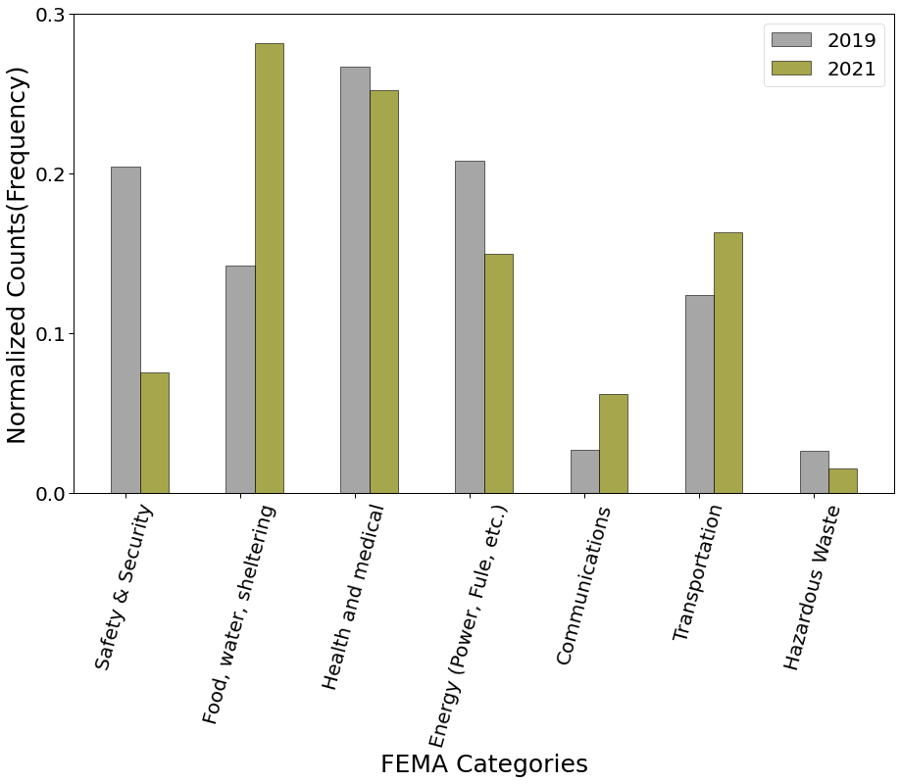
Exploratory Data Analysis FEMA’s 7 lifelines (comparison)
Significant increase in Food, Water and Shelter category during pandemic.
Health & Medical as a lifeline, shows a little drop due to some sub categories like counselling and mental health and urgent care, not a priority during pandemic.
Notes:
2019: 1283
2021:1908

Slide 7
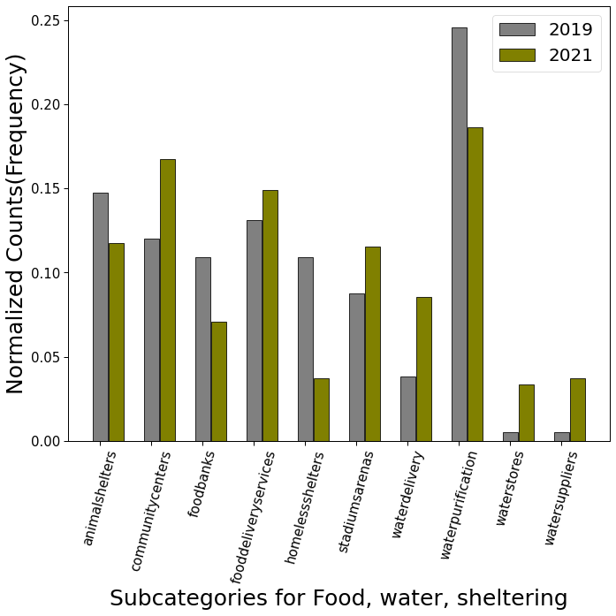
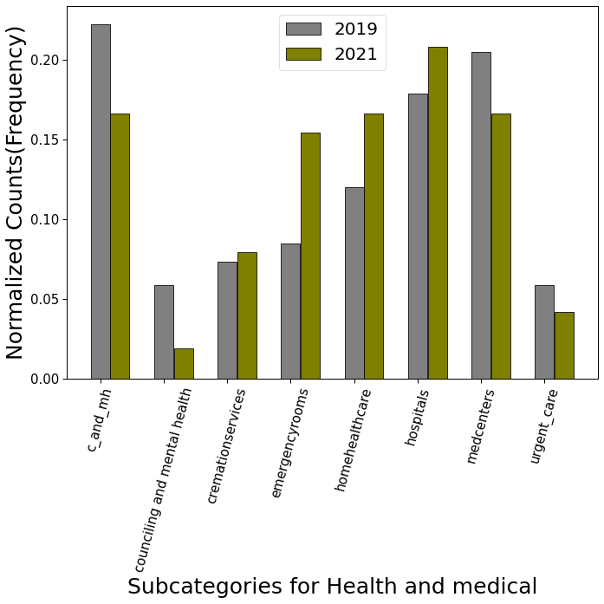
Exploratory Data Analysis Lifeline Subcategories (comparison)
Notes:
The priority for Health and Medical has shifted from mental counselling to healthcare, emergency rooms and hospitals.

Slide 8
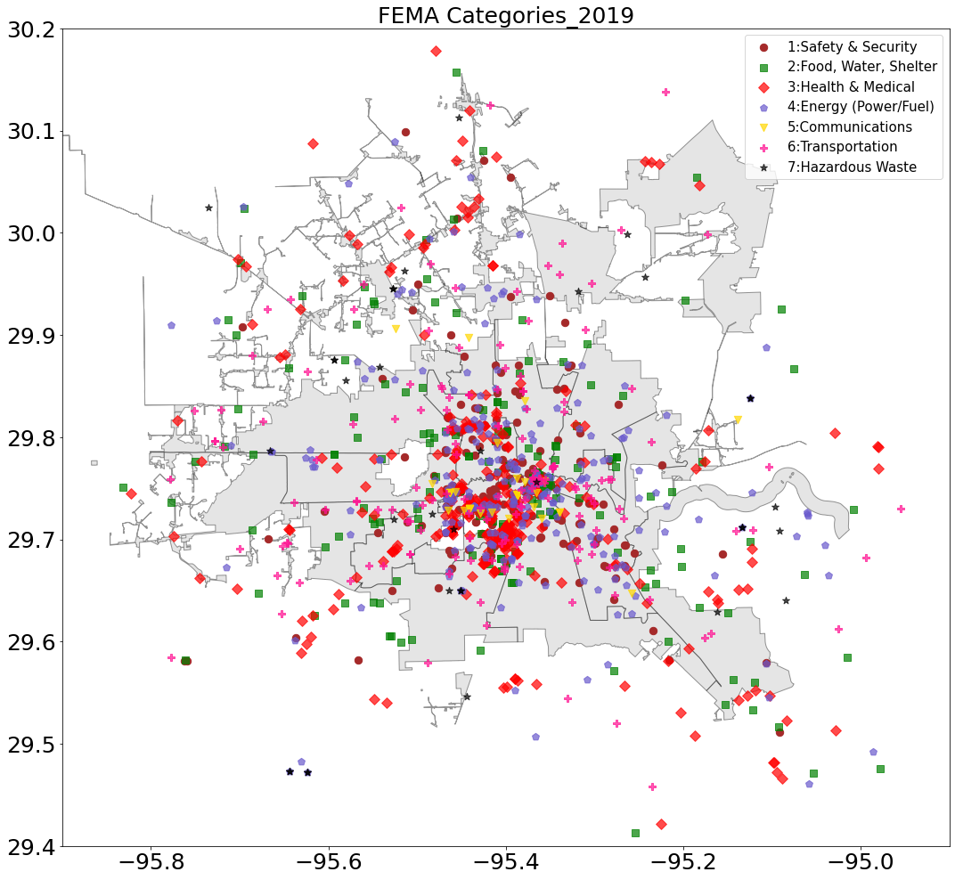
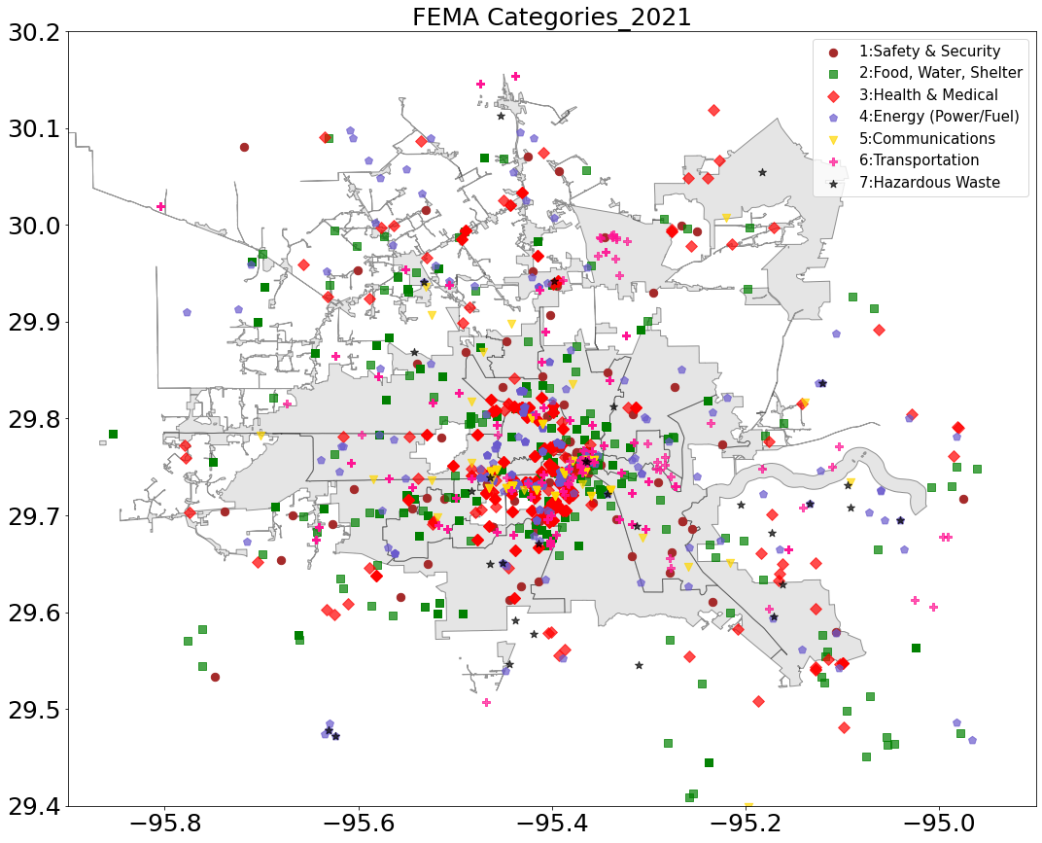
Exploratory Data Analysis Lifeline Spread 2019 Vs 2021
Notes:
Food and Shelter on bottom-left, bottom-right overall food and water distribution looks well spread.
Safety and Security – Spread is more even in 2021 compared to 2019.
Communication – more spread out for 2021.

Slide 9
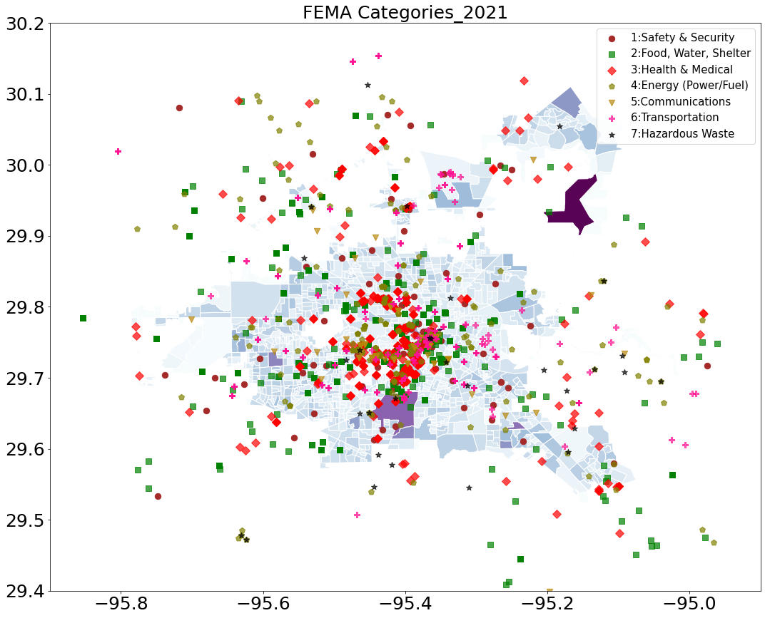
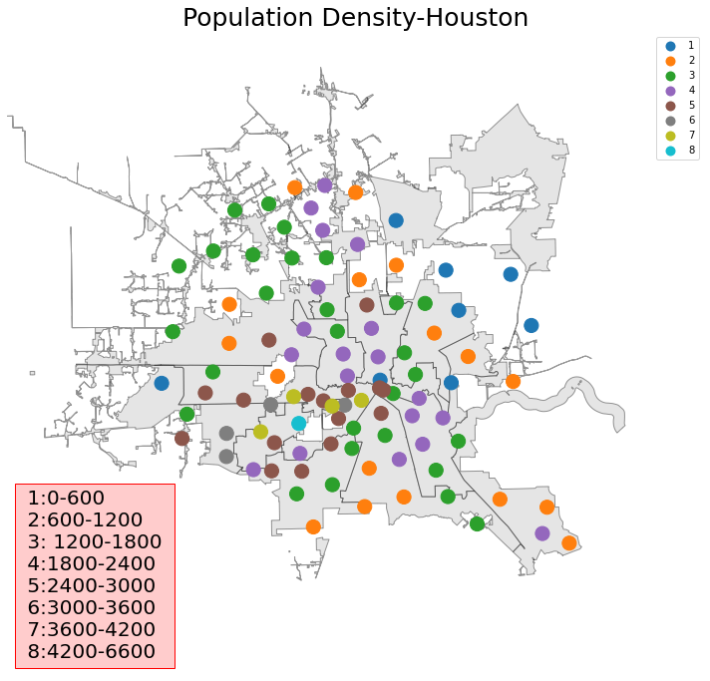
Exploratory Data Analysis Lifeline Spread 2021 (by population)

Slide 10
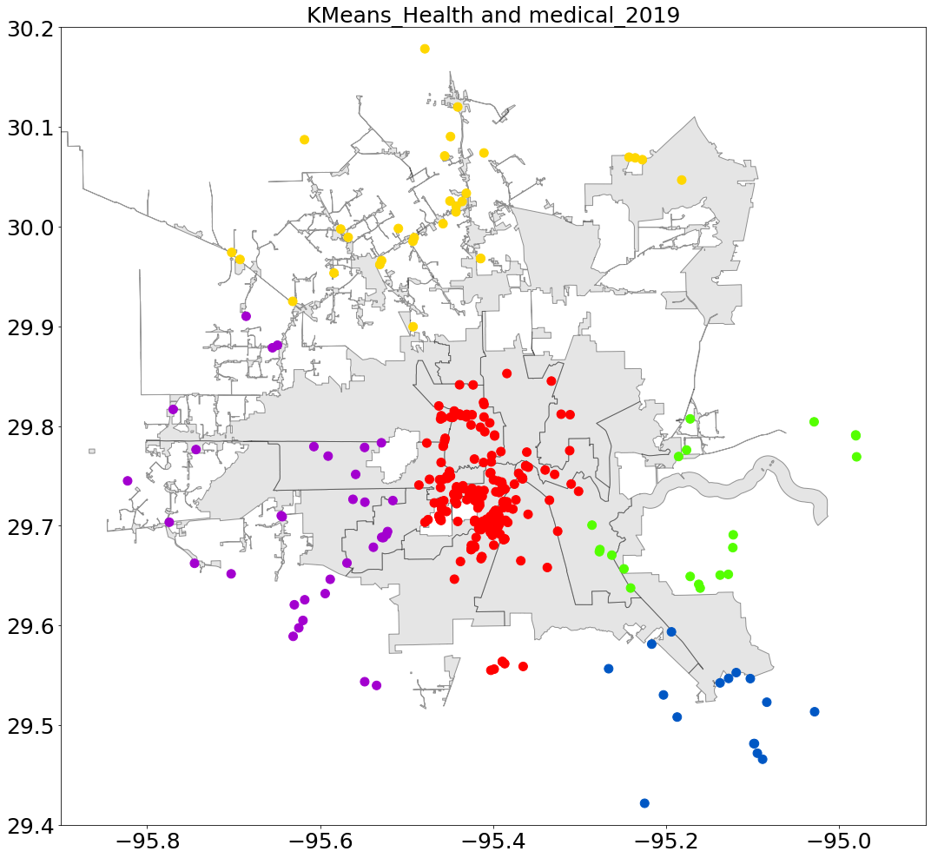
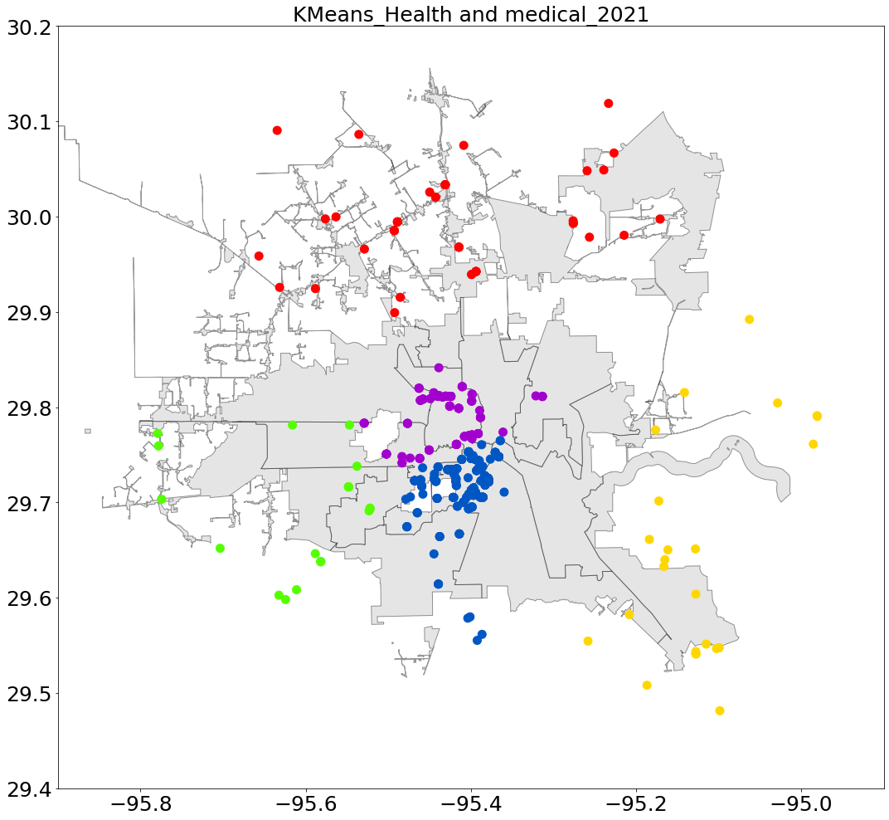
Clustering each Lifelines - KMeans
Silhouette_score=0.57
Silhouette_score=0.44

Slide 11
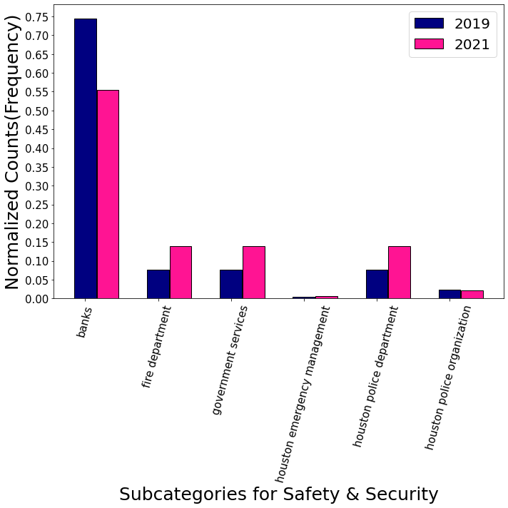
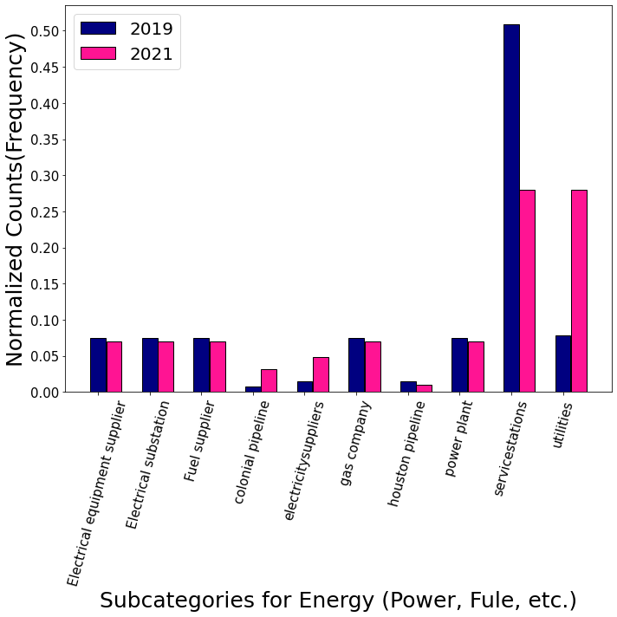
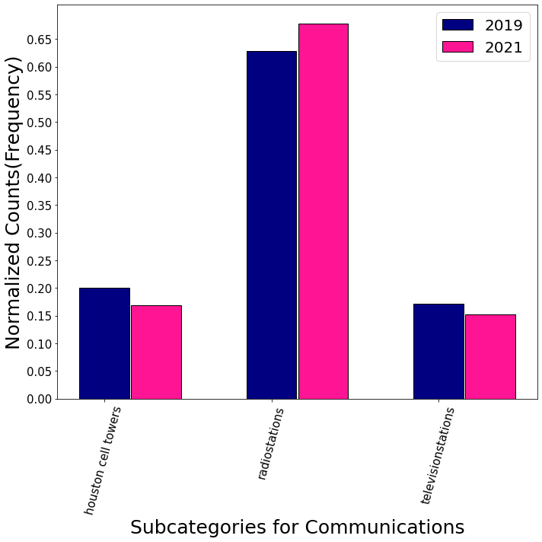
Summary and Conclusions
Focus on lifelines increased between 2019 and 2021.
Banks were affected by shutting down of various businesses and hence number of branches were shut down or operated with reduced hours.
Less important businesses like service stations dropped significantly by 2021, while the utilities went up.
Radio stations were used as a major means of communication compared to television stations, which will require more people to operate.
Overall, priority of lifelines shifted because the focus of government shifted.
Overall Lifelife Spread

Slide 12
References
Data Collection
Yelp API - https://www.yelp.com/developers/documentation/v3/business_search
Requests Library - https://realpython.com/python-requests/
Google Cloud - https://console.cloud.google.com/apis/library?authuser=2&project=yelpbusinesssinfo
Lee Robinsons Blog on retrieving data using different API’s https://leerob.io/blog/google-yelp-foursquare-apis-python Houston population data - https://www.census.gov/en.html
using Foursqare API - https://developer.foursquare.com/docs/api-reference/venues/details/
Houston Information - https://www.houston.org/sites/default/files/2020-08/Houston%20Facts%202020_1.pdf
EDA
Geopandas - https://geopandas.org/getting_started.html
Youtube tutorial on using Geopandas - https://www.youtube.com/watch?v=t7lliJXFt8w&t=1s
Reading shapefile Spatial data - https://geopandas.org/docs/user_guide/io.html

Slide 13
Thank you

